Slide 1
Blood Bank Management System
Group Members:
Anish Kumar Goit
Dinesh Rimal
Kusal Rimal
--

Slide 2
Agenda:
Introduction
Problem Statement
Objectives
Features
Diagram
Gantt Chart
Platform and Tools
Conclusion

Slide 3
Introduction
A Blood Bank Management System helps manage blood inventory, donor information, and blood transfer requests.
It organizes blood inventory and donor data efficiently.
Blood donation management and ensuring blood availability can be complex. The system streamlines these processes for easier and more effective blood bank operations.

Slide 4
Problem Statement:
Manual Record-Keeping
Lack of Centralized System
Inefficient Inventory Management
Limited Donor Engagement
Notes:
Missed Vaccinations: Manual record-keeping often leads to lost or damaged vaccination cards, causing children to miss important doses and remain vulnerable to diseases.
Lack of Centralized Records: With no national digital database, healthcare providers cannot easily access a child’s vaccination history, especially when families move or visit different health centers.
Communication Gaps: Parents are not always reminded about upcoming doses, and healthcare workers have no efficient way to follow up, leading to delays or incomplete immunization.
Limited Digital Access in Rural Areas: Families in remote locations often lack timely access to child health information, making it harder to track vaccinations.
Need for a Digital Solution: An accessible, centralized, and secure vaccination tracker is essential to improve communication, reduce missed doses, and support government health goals

Slide 5
Objectives:
To develop a simple and efficient Blood Bank Management System using Java and MySQL for managing donor details and blood inventory. for recording and managing child vaccination data.

Slide 6
Features:
Donor Management: Add, update, view, and track donor details and donation history.
Blood Inventory Management: Monitor blood stock levels, types, and expiry dates.
Blood Stock Statistics: Track increases and decreases in blood units over time.
Blood Request & Distribution: Process hospital requests and prioritize emergency needs.
User Authentication & Security: Secure login and role-based access for authorized users.
Reporting & Analytics: Generate reports on donations, inventory, and distribution trends.
User-Friendly Interface: Easy navigation for admins.
Donation Center: Manage multiple blood donation centers, record collection details, and monitor blood availability at each center.

Slide 7
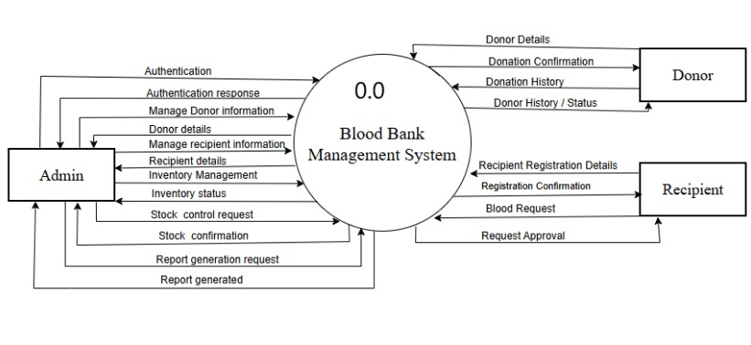
DFD-0 Diagram
Fig: DFD-0

Slide 8
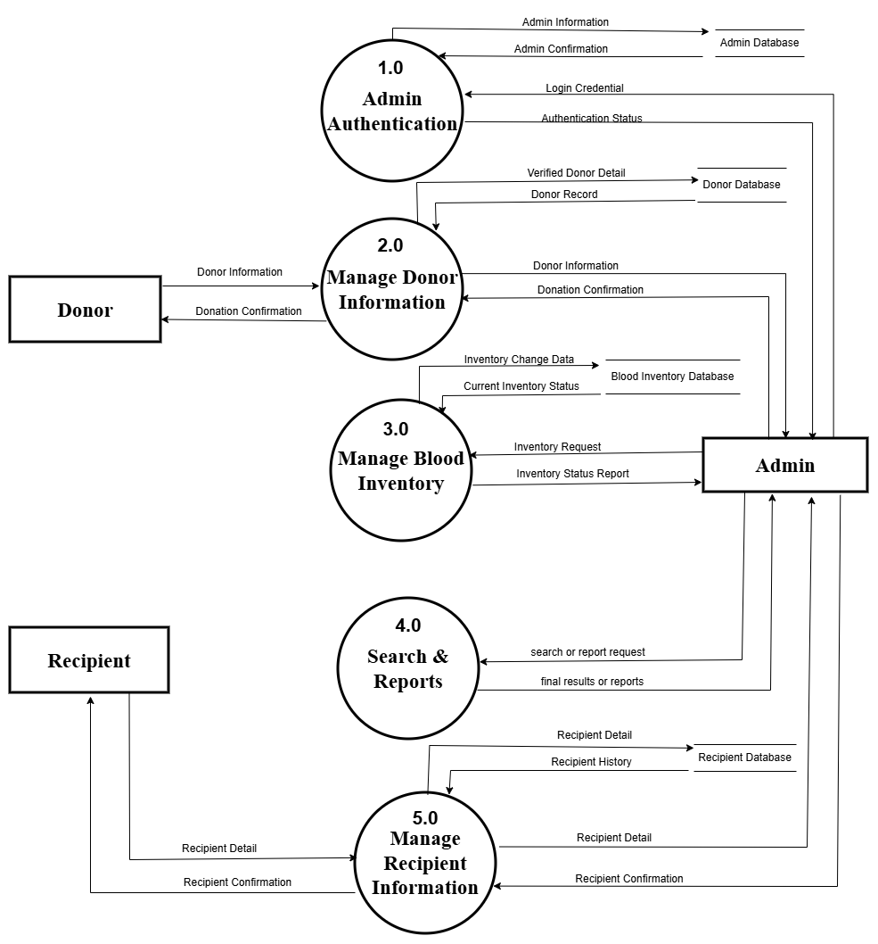
Diagram
Fig: DFD-1

Slide 9
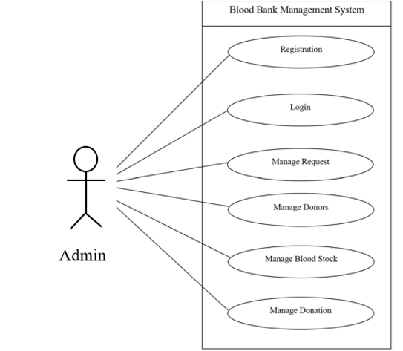
Use Case Diagram
Fig: Use Case Diagram

Slide 10
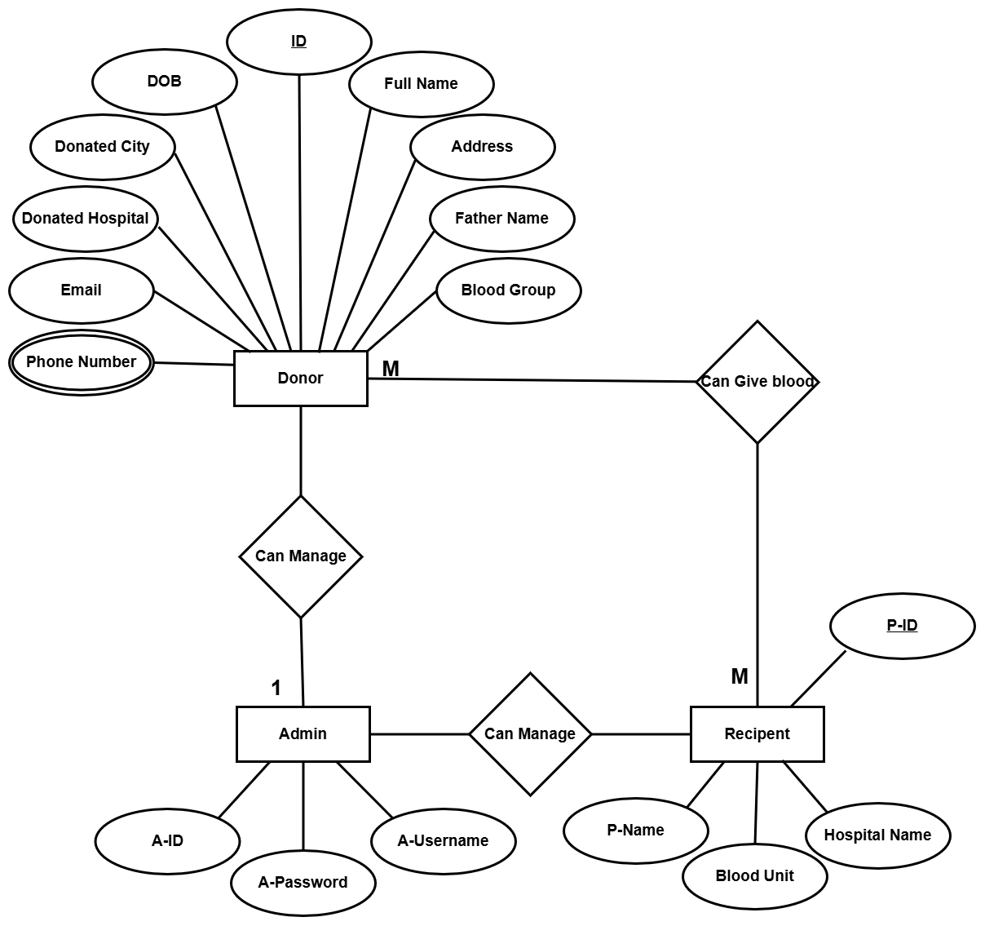
E-R Diagram
Fig: ER-Diagram

Slide 11
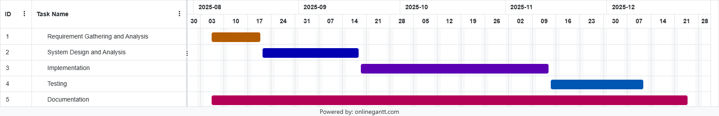
Gantt Chart
Fig: Gantt Chart

Slide 12
Platform and Tools
Programming Language: Java
Development Environment:
IDE: Intellij IDE
Database: MySQL
PDF Library: iText version 7

Slide 13
Conclusion
Improved Efficiency: The system streamlines blood bank operations, reducing manual paperwork and administrative overhead. This leads to improved efficiency in managing donor information and blood inventory.
Enhanced Admin Engagement: By providing a user-friendly platform for admins to register and update donor information, the system promotes admin engagement contributing to a sustainable blood supply.
Data Accuracy: The system ensures the accuracy and integrity of donor information, enabling healthcare professionals to make informed decisions regarding blood transfusions and patient care.

Slide 14
THANK YOU!!

